Slide 1
Matrix Multiplication
Properties

Slide 2
Not Communicative
$AB≠BA$
Notes:
可以舉個例子嗎

Slide 3
Not Communicative
$$m×n$$
$$n×p$$
A
B
$$y$$
$$v$$
$$x$$
B
A
$$y′$$
$$v′$$
$$x$$
接不起來 …
$$n×p$$
$$m×n$$
m x m
n x n
If A and B are matrices, then both AB and BA are defined if and only if A and B are square matrices?
A: m x n, B: n x m

Slide 4
Properties
Let A and B be k x m matrices, C be an m x n matrix, and P and Q be n x p matrices
For any scalar s, s(AC) = (sA)C = A(sC)
(A + B)C = AC + BC
C(P+Q)=CP+CQ
I_{k}A = A = AI_{m}
The product of any matrix and a zero matrix is a zero matrix
Power of square matrices: A is n x n, A^{k} = A A☹ A (k times), and by convention, A¹ = A, A⁰ = I_{n}

Slide 5
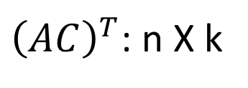
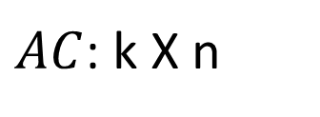
Properties
$AC$: k X n
${\left(AC\right)}^{T}$: n X k
Let A be kxm matrices, C be an mxn matrix,
${\left(AC\right)}^{T}=?$
$${C^{T}A}^{T}$$
$$A^{T}C^{T}$$
$${C^{T}A}^{T}$$
m X k
n X m
n X m
m X k
n X k
Notes:
Represented by $A^{T}$ and $C^{T}$

Slide 6
Special Matrix
Diagonal Matrix
Symmetric Matrix
$$A^{T}=A$$
AA^{T} and A^{T}A are square and symmetric
Square:
A is m x n
AA^{T}
m x m
A^{T}A
n x n
m x n
n x m
n x m
m x n
Symmetric:
$${\left(AA^{T}\right)}^{T}$$
$$=A^{TT}A^{T}$$
$$=AA^{T}$$
$${\left(A^{T}A\right)}^{T}$$
$$=A^{T}A^{TT}$$
$$=A^{T}A$$

Slide 7
Practical Issue
Let A and B be k x m matrices, C be an m x n matrix, and P and Q be n x p matrices
A(CP) = (AC)P
n
p
m
n
……
……
Multiplication count:
m X n X p

Slide 8
Practical Issue
k=1
m=1000
n=1
p=1000
Let A and B be k x m matrices, C be an m x n matrix, and P and Q be n x p matrices
A(CP) = (AC)P
A
C
P
A
C
P
k X m
m X n
n X p
k X m
m X n
n X p
m X n X p
k X m X n
10⁶
10³
A
CP
AC
P
k X m X p
k X n X p
k X m
m X p
k X n
n X p
10⁶
10³

